Slide 1
Interreg IPA
Romania-Serbia Programme
Cooperation beyond borders!
Dr.Tr. Severin, Romania
Programme co-financed by the European Union

Slide 2
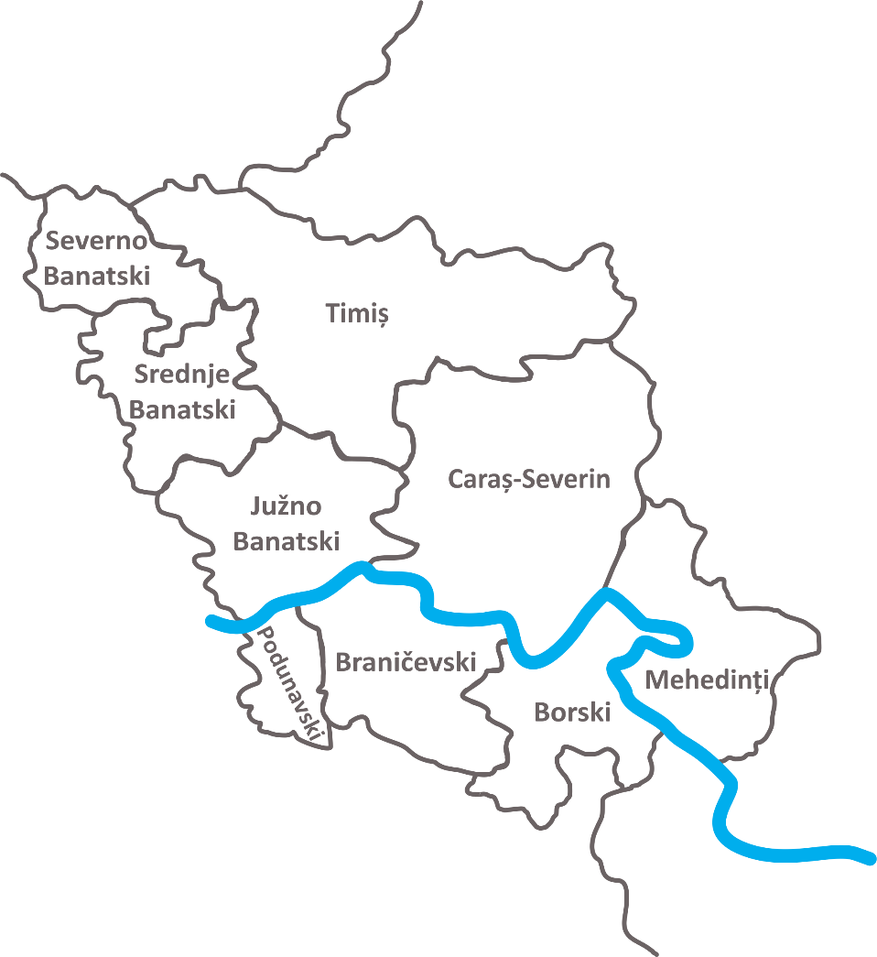
Eligible area:
Romania – 3 counties:
Timiş
Caraş-Severin
Mehedinţi
Republic of Serbia – 6 districts:
Severnobanatski
Srednjebanatski
Južnobanatski
Podunavski
Braničevski
Borski

Slide 3
STEPS TO FOLLOW IN ACCESSING FUNDS
The 5 main phases of the process of accessing funds:
Identifying the need at the organizational level
Identifying a partner, on the other side of the border, with the same type of need
Signing the partnership agreement
Project preparation
Project submission

Slide 4
Eligibility criteria
1. Eligibility of applicants
Partners must fulfil the following criteria:
Be non-profit making bodies and legally established according to the national legislation of the state on whose territory they are located.
Public authorities, public bodies and bodies governed by public law.
Minimum number of partners: | 2 | One from each side of the border
Maximum number of partners: | 5 | Including the Lead Partner

Slide 5
Eligibility criteria
Cooperation criteria:
Joint development – (mandatory)
Joint implementation – (mandatory)
Joint financing – (mandatory)
Joint staffing – (optional)

Slide 6
Eligibility criteria
2. Eligibility of actions (operations)
Partners must fulfil the following criteria:
To be carried out within the Programme area.
Have cross-border impact on the Programme area.
Contribute to the objectives of the Programme.

Slide 7
Eligibility criteria
PRIORITY and specific objectives
Priority 1: Environmental protection and risk management
SO 1.1 - Enhancing protection and preservation of nature, biodiversity and green infrastructure, including in urban areas, and reducing all forms of pollution
SO 1.2 - Promoting renewable energy in accordance with Directive (EU) 2018/2001, including the sustainability criteria set out therein
SO 1.3 - Promoting energy efficiency and reducing green-house gas emissions
SO 1.4 - Promoting climate change adaptation and disaster risk prevention and resilience, taking into account ecosystem-based approaches

Slide 8
Eligibility criteria
PRIORITY and specific objectives
Priority 2: Social and economic development
SO 2.1 - Improving equal access to inclusive and quality services in education, training and life-long learning through developing accessible infrastructure, including by fostering resilience for distance and on-line education and training
SO 2.2 - Ensuring equal access to health care and fostering resilience of health systems, including primary care, and promoting the transition from institutional to family-based and community-based care
SO 2.3 - Enhancing the role of culture and sustainable tourism in economic development, social inclusion and social innovation

Slide 9
Eligibility criteria
3. Eligibility of expenditure
The IPA funds requested for one project will range between
250,000 Euro and 2,000,000 Euro
Specific details regarding eligible expenditures are available in Annex F - List of eligible expenditures.
The eligibility of expenditure applies to both public and own contribution, so it is not possible to consider an ineligible expenditure as own contribution.

